Slide 1
Weighted Shortest Path
Dijkstra: Algorithm
Dijkstra(S, G):
Initialize: PriorityQueue (PQ), visited HashSet, parent HashMap, and distances to infinity
Add (S, 0) onto the PriorityQueue
while PQ is not empty:
dequeue node curr from front of queue
if(curr is not visited)
add curr to the visited set
if(curr == G) return parent map
for each of curr’s neighbors, n, not in visited set:
if(path through curr to n is shorter)
update n’s distance
update curr as n’s parent in parent map
enqueue (n, distance) onto the PQ
// if we made it here then there’s no path

Slide 2
Dikstra’s Algorithm – finding the shortest path
Let the node at which we are starting be called the initial node. Let the distance of node Y be the distance from the initial node to Y. Dijkstra’s algorithm will assign some initial distance values and will try to improve them step by step.
Assign to every node a tentative distance value: set it to zero for our initial node and to infinity for all other nodes.
Set the initial node as current. Mark all other nodes unvisited. Create a set of all the unvisited nodes called the unvisited set.
For the current node, consider all of its unvisited neighbors and calculate their tentative distances. Compare the newly calculated tentative distance to the current assigned value and assign the smaller one. For example, if the current node A is marked with a distance of 6, and the edge connecting it with a neighbor B has length 2, then the distance to B (through A) will be 6 + 2 = 8. If B was previously marked with a distance greater than 8 then change it to 8. Otherwise, keep the current value.
When we are done considering all of the neighbors of the current node, mark the current node as visited and remove it from the unvisited set. A visited node will never be checked again.
If the destination node has been marked visited (when planning a route between two specific nodes) or if the smallest tentative distance among the nodes in the unvisited set is infinity (when planning a complete traversal; occurs when there is no connection between the initial node and remaining unvisited nodes), then stop. The algorithm has finished.
Otherwise, select the unvisited node that is marked with the smallest tentative distance, set it as the new “current node”, and go back to step

Slide 3
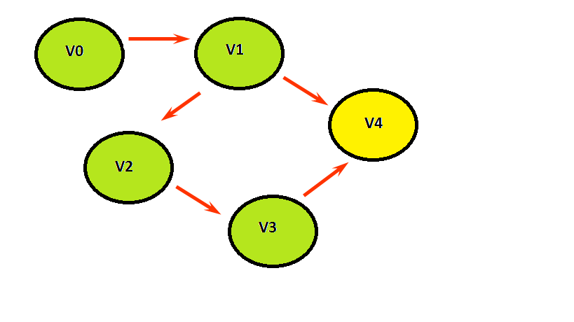
Weighted Shortest Path
0
2
∞
∞
2
V0
V1
6
∞
8
6
1
∞
V4
3
V2
5
∞
1
2
V3
{V4, 6}
{V4, 8}
{V1,2}
{V4, 8}
{V3, 5}
PQ:
curr:
visited:
{V2, 3}
{V0, 0}
{V4, 8}
STOP
V1
V0
V3
V2
V4
V1
V2
V0
V3
V4

Slide 4
Dijkstra Round Two
Dijkstra: Algorithm
For each vertex, keep track of
Cost: The cost of the cheapest path we’ve found to this vertex
Previous: The previous vertex on the cheapest path
Done: A bit telling us whether we have found the shortest path to this vertex yet.

Slide 5
Dijkstra Round Two
V1
4
V2
2
V4
2
1
3
2
2
curr
V0
V3
V5
1
2
source
V0 V1 V2 V3 V4 V5
0
∞
∞
∞
∞
∞
4
3
Cost
3
2
1
Previous
0
0
0
2
3
Done
T
F
T
F
T
F
T
T
F
T
F

Slide 6
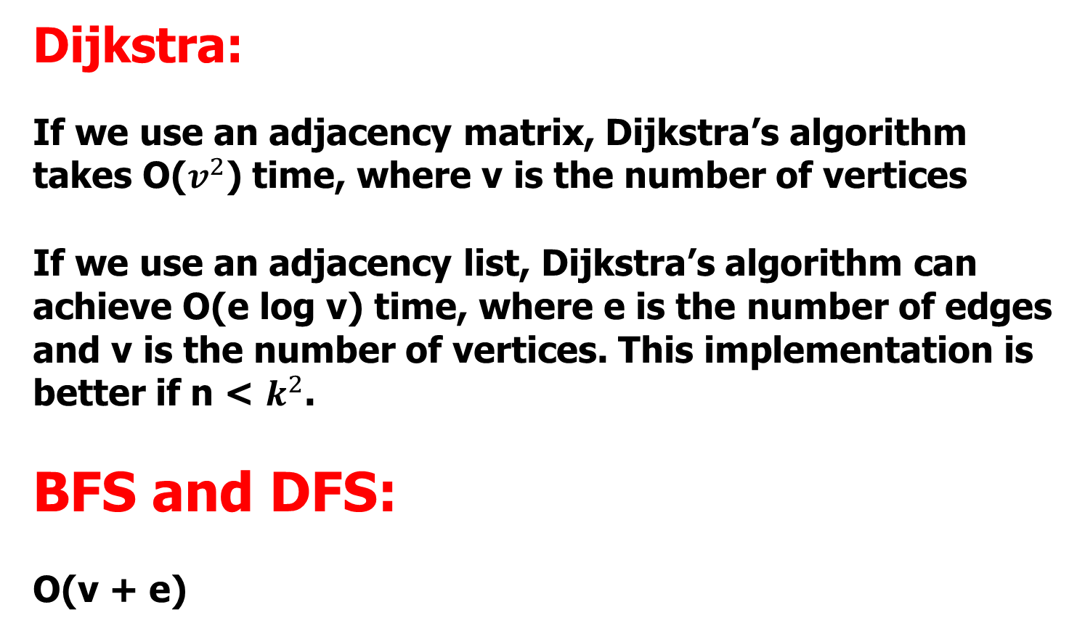
Big O

Slide 7
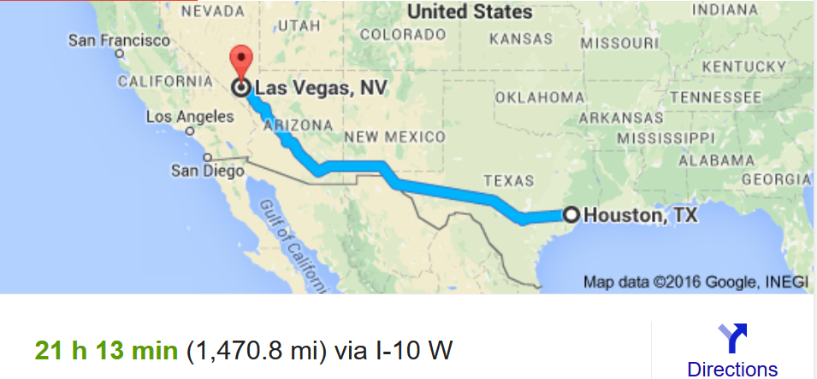
Dijkstra’s Algorithm
We should consider the distance from the target too!
Dijkstra’s only considers distance from source
(1,130 mi) from Oklahoma City to Las Vegas and (442.3 mi) from Houston to Oklahoma City

Slide 8
A* Algorithm
PriorityQueue ordering is based on
f(n) = g(n) + h(n)
where g(n) is the cost or distance from start to vertex and
h(n) is the heuristic estimated cost from vertex n to goal vertex

Slide 9
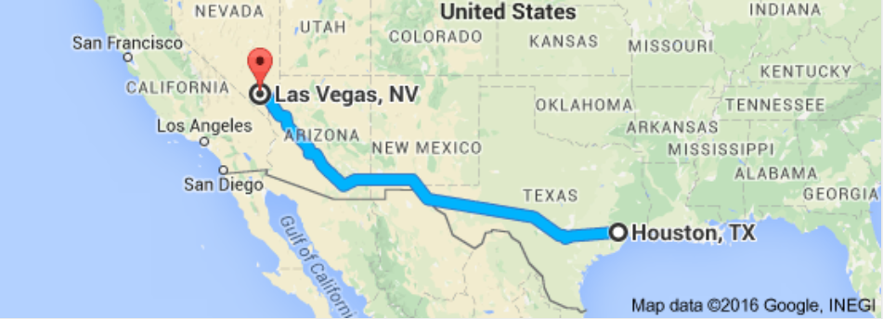
A* Algorithm

Slide 10
Mazes
Mazes are essentially graphs as you have to travel around the maze to see if an exit exists. You will be checking vertices and travelling along the edges.
* * * * * *
* . . . . *
* . . * * *
* S . . . *
* . . . E *
* * * * * *
. are paths
* are walls

Slide 11
Mazes
Maze problems are very common
programming problems.
. * * * * *
. . . . . .
* . . * . .
* . * * * *
* . * . . *
* * . * . .
Other times, you start at 0,0 and must check to see if you can get to length-1, length-1.
. are paths
* are walls

Slide 12
Mazes
void search(int row, int col)
{
if (row >= 0 && col >= 0 && row < maze.length && col < maze[r].length && maze[row][col] = = 1)
{
if (col = = maze[r].length - 1) {
exitFound = true;
}
else {
maze[row][col] = 0; //marking
search(row+1, col);
search(row-1, col);
search(row, col+1);
search(row, col-1);
}
}
}
1 0 1 1 1
0 1 1 1 1
1 1 1 1 0
0 0 0 0 1
0 0 1 1 0

Slide 13
Mazes
In some situations, you want to
make changes to the maze
temporarily. For instance, if you are trying to determine the shortest path, you have to find all
paths and determine which path is the shortest. Each time to you search the maze for a path, the maze must be in its original state.

Slide 14
Mazes
void search(int row, int col)
{
if (row >= 0 && col >= 0 && row < maze.length &&
col < maze[r].length && maze[row][col] = = 1)
{
if (col = = maze[r].length - 1) {
exitFound = true;
}
else {
maze[row][col] = 0; //marking
search(row+1, col);
search(row-1, col);
search(row, col+1);
search(row, col-1);
maze[row][col] = 1; //unmarking ( set it back )
}
}
}

